Slide 1

Project : Insurance Industry Batch Name : Batch A_AWS | P02 (Class: A1) Checkpoint 1 Presentation Group Members : 1. Piyush Kumar 2. Muthres Gurjar 3. Ashutosh Maharana 4. Banala Viswa Sahith 5. Nithya Sai Sandarshini Veerla

Slide 2
Agenda
Overview of Problem Statements
Business Problem
Objective of Checkpoint 1
Task 1.1. Data Analysis
Dataset Overview
Dataset Balancing & Duplicates Analysis
Pearson Correlation Analysis
Spearman Correlation Analysis
Claim Rate Analysis
Task 1.2. ER Diagram and Oracle Database Design
E-R Diagram
Characteristics of Relations
Conclusion

Slide 3
Business Problem and Project Objective

Slide 4
Overview of Problem Statements
Business Problem
XYZ Insurance wants to identify policyholders who are likely to file an insurance claim in the next six months.
Relevant information is spread across policy, car, and insurance claim datasets.
Objective of Checkpoint 1
Analyze the datasets using Python.
Identify patterns between policy/car features and claim status.
Design an ER diagram and create related Oracle database tables.
Use SQL queries to generate business-relevant insights.
The goal is to convert raw insurance data into actionable insights that support risk segmentation and future claim prediction.

Slide 5
Task 1.1. Data Analysis

Slide 6
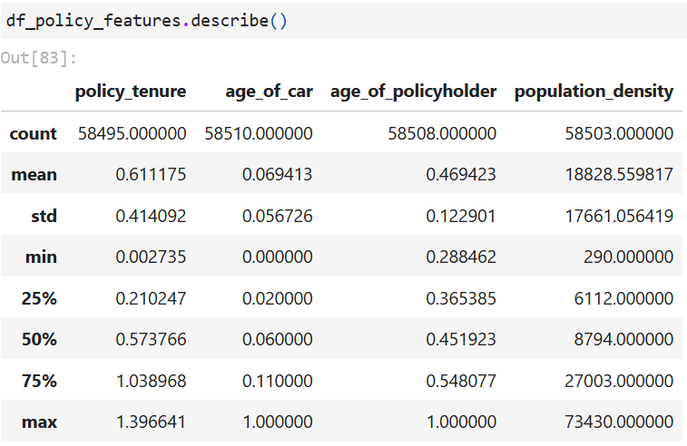
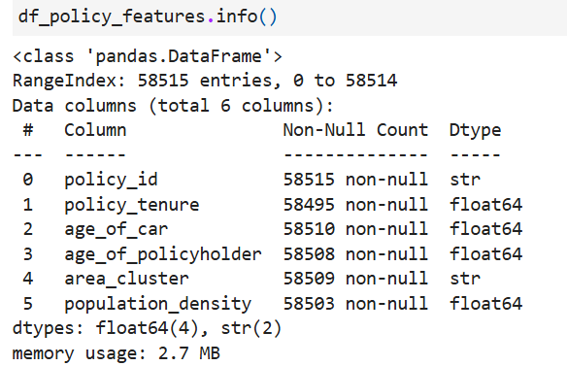
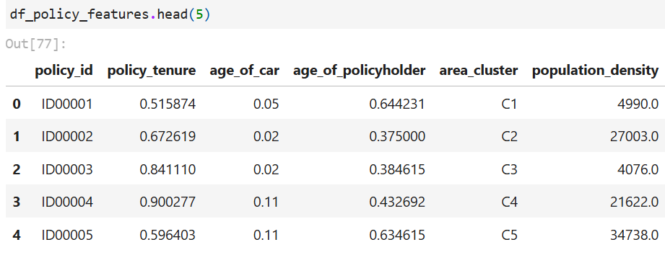
Data Analysis: Dataset Overview
D2: Car Features
D3: Policy Features
D1:Insurance Claim
Notes:
Here are some indicative types of analysis you can perform. Please note that this is not an exhaustive list, you may add more
Come up with appropriate results for the following:
1. Analyse the policy features. Identify the pattern and figure out if there is any relation with the insurance claim.
2. Is the dataset balanced? Are there duplicates in the data?
3. Investigate the various car features and find out the important features that affects the insurance claim.

Slide 7
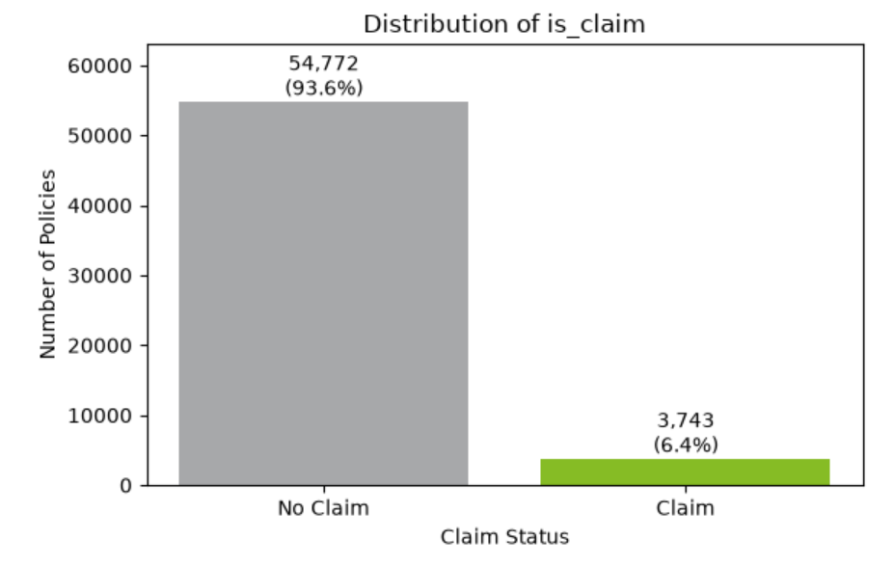
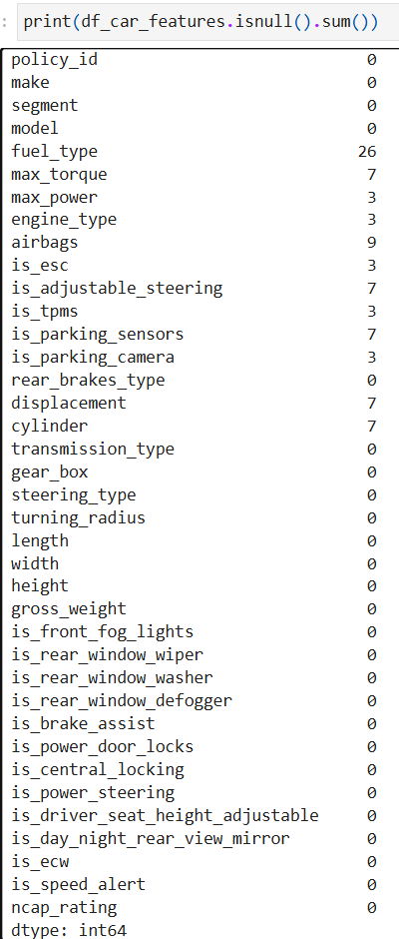
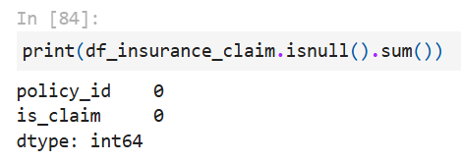
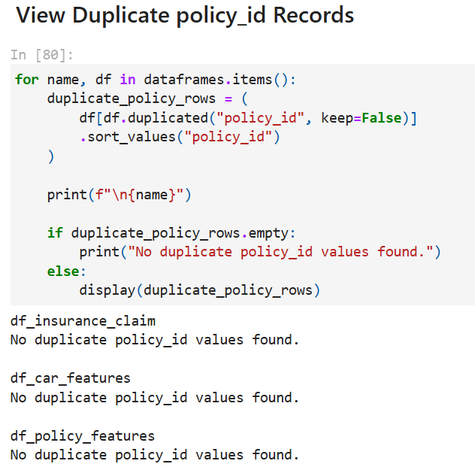
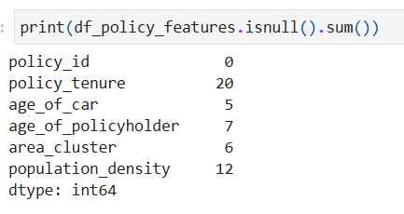
Data Analysis: Dataset Balancing & Duplicates Analysis
Imbalanced Dataset
Null Values in each dataset
D1: Insurance Claim
D2: D2: Car Features
D3: Policy Features
No Duplicates Found
Notes:
Here are some indicative types of analysis you can perform. Please note that this is not an exhaustive list, you may add more
Come up with appropriate results for the following:
1. Analyse the policy features. Identify the pattern and figure out if there is any relation with the insurance claim.
2. Is the dataset balanced? Are there duplicates in the data?
3. Investigate the various car features and find out the important features that affects the insurance claim.

Slide 8
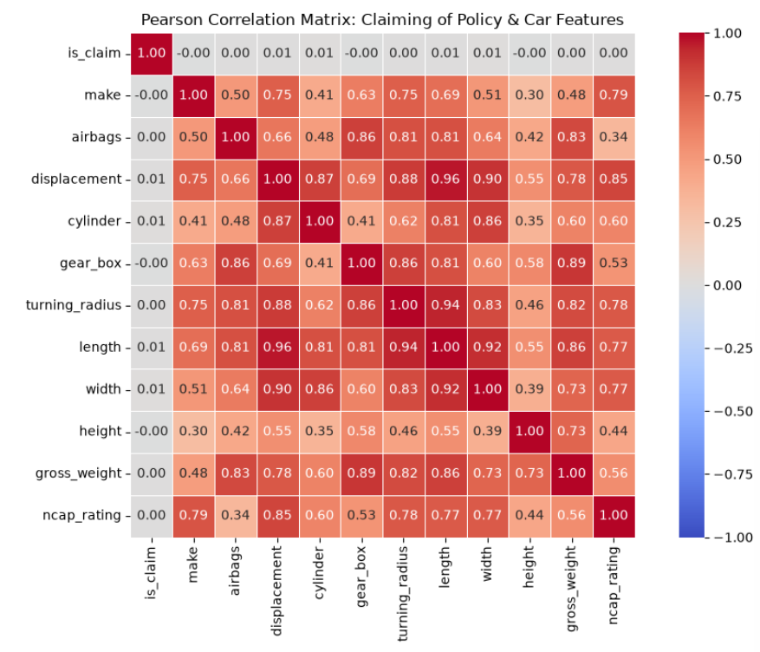
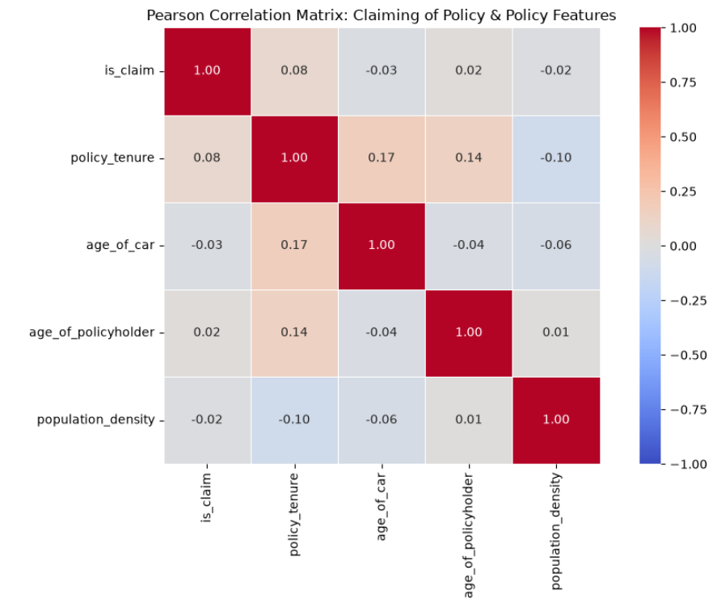
Data Analysis: (Pearson Correlation Analysis)
No significant Linear Correlation found among “Policy Claim” and other features
Notes:
Here are some indicative types of analysis you can perform. Please note that this is not an exhaustive list, you may add more
Come up with appropriate results for the following:
1. Analyse the policy features. Identify the pattern and figure out if there is any relation with the insurance claim.
2. Is the dataset balanced? Are there duplicates in the data?
3. Investigate the various car features and find out the important features that affects the insurance claim.

Slide 9
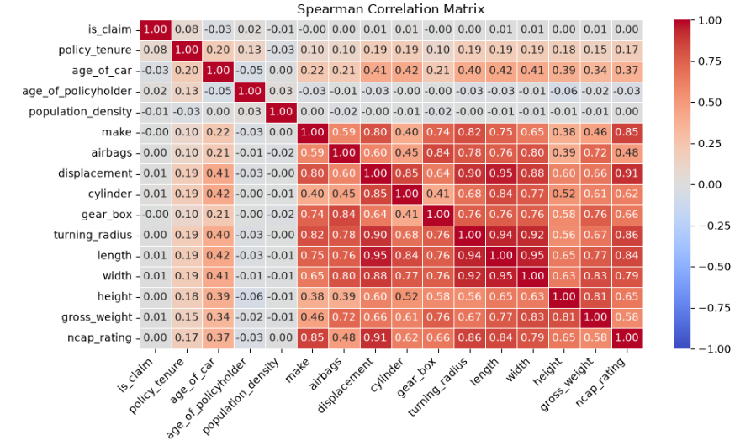
Data Analysis contd. (Spearman Correlation Analysis)
No significant monotonic relationship exists between “Policy Claiming” & other features
Notes:
Here are some indicative types of analysis you can perform. Please note that this is not an exhaustive list, you may add more
Come up with appropriate results for the following:
1. Analyse the policy features. Identify the pattern and figure out if there is any relation with the insurance claim.
2. Is the dataset balanced? Are there duplicates in the data?
3. Investigate the various car features and find out the important features that affects the insurance claim.

Slide 10
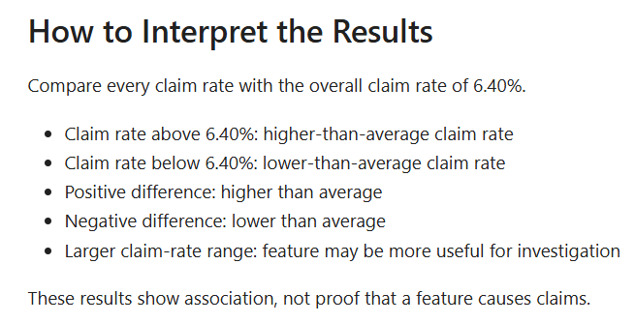
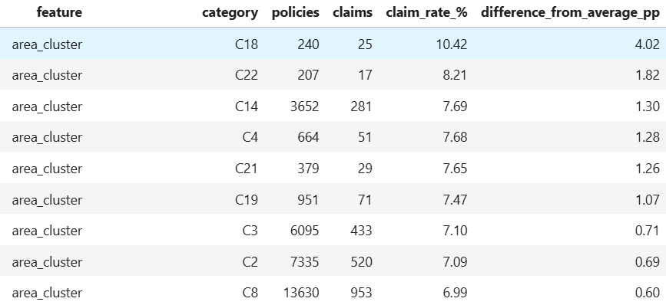
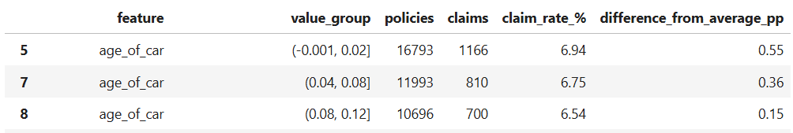
Data Analysis contd. (Claim Rate Analysis)
Categorical Features showing above average claim rate
Numerical Features showing above average claim rate
Avg. Insurance Claim Rate = 6.4%
Notes:
Here are some indicative types of analysis you can perform. Please note that this is not an exhaustive list, you may add more
Come up with appropriate results for the following:
1. Analyse the policy features. Identify the pattern and figure out if there is any relation with the insurance claim.
2. Is the dataset balanced? Are there duplicates in the data?
3. Investigate the various car features and find out the important features that affects the insurance claim.

Slide 11
Task 1.2. ER Diagram and Oracle Database Design

Slide 12
ER Diagram and Oracle Database Design: E-R Diagram
Policy_features
Describes
Has
Car Features
Insurance_claim

Slide 13
ER Diagram and Oracle Database Design: Characteristics of Relations
policy_features
primary key :- policy_id
Check constraints policy_tenure >= 0 age_of_car >= 0 age_of_policyholder >= 0 population_density >= 0
Car_features
Primary Key :- policy_id FOREIGN KEY :- policy_id REFERENCES policy_features
Check Constraints
airbags >= 0 gross_weight > 0 ncap_rating BETWEEN 0 AND 5
insurance_claim
PRIMARY KEY :- policy_id FOREIGN KEY policy_id REFERENCES policy_features CHECK
is_claim IN (0, 1)
Cardinality
CARFEATURES N -1 POLICY_FEATURES
POLICY_FEATURES 1 -N INSURANCE_CLAIM
Notes:
Here are some indicative types of analysis you can perform. Please note that this is not an exhaustive list, you may add more
Come up with appropriate results for the following:
1. Analyse the policy features. Identify the pattern and figure out if there is any relation with the insurance claim.
2. Is the dataset balanced? Are there duplicates in the data?
3. Investigate the various car features and find out the important features that affects the insurance claim.

Slide 14
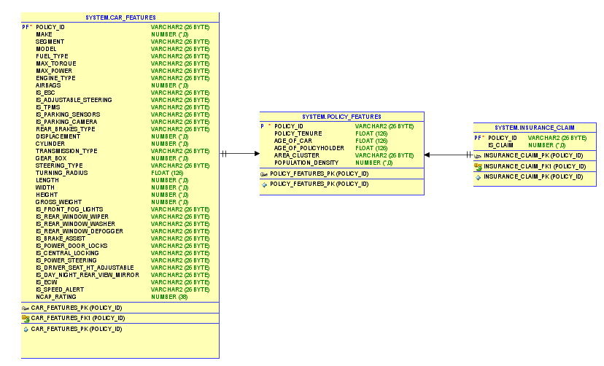
ER Diagram and Oracle Database Design: Schema Diagram

Slide 15
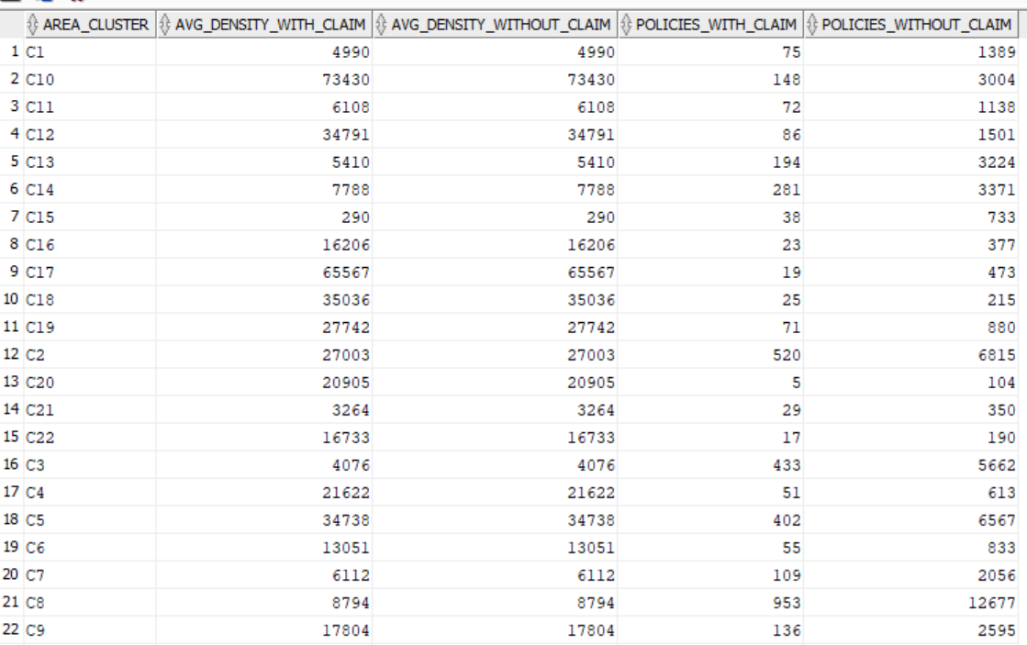
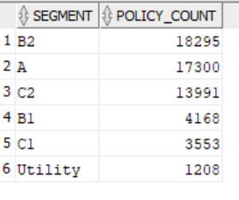
Average Population Density by Claim Status and Area Cluster
Car Segments with 100+ Policies

Slide 16
Conclusion & Key Takeaways
The dataset contains 58,515 policy records with a common policy_id. No duplicate policy IDs were identified. The overall claim rate is approximately 6.4% Designed a relational database linking policy, car, and insurance claim data through the common policy_id.
Created the ER model, Oracle tables, relationships, and data-loading process required for the project.
Developed SQL queries to analyze claim patterns, population density, vehicle safety, car segments, policy tenure, and car age categories.

Slide 17
Thank You
pikumar6@deloitte.com
mgurjar@deloitte.com
asmaharana@deloitte.com
vibanala@deloitte.com
vnithyasaisandarshin@deloitte.com

